Slide 1
Persistence: Files and Directories
Dr. Probir Roy
Some slides are modified from
* Dr. Shengquan Wang
Operating Systems: Three Easy Pieces, by Remzi H. Arpaci-Dusseau and Andrea C. Arpaci-Dusseau
Operating System Concepts, 8th edition, by Silberschatz, Galvin, Gagne, John Wiley & Sons, 2009
Notes:
1

Slide 2
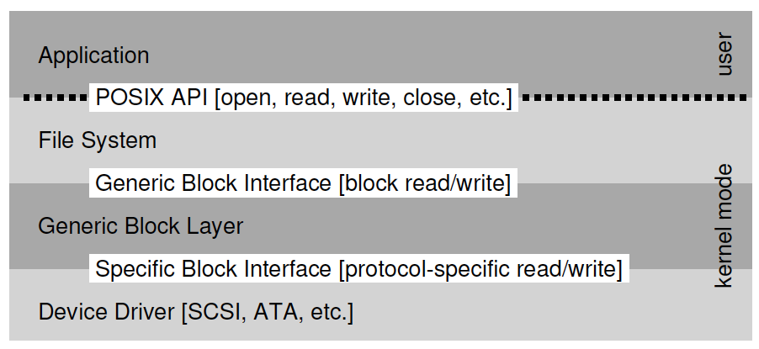
Example of abstraction: Linux file system stack

Slide 3
Outline
Abstraction: file

Slide 4
File
A file is simply a linear array of bytes, each of which you can read or write.
Each file has some kind of low-level name, usually a number of some kind:
For historical reasons, it is often referred to as its inode number.
The user is normally not aware of this name.
The file system is to store the data persistently on disk and make sure that when you request the data again.
Unaware of the structure of the file (e.g., whether it is a picture, or a text file, or C code).

Slide 5
Outline
Abstraction: file
Abstraction: directory

Slide 6
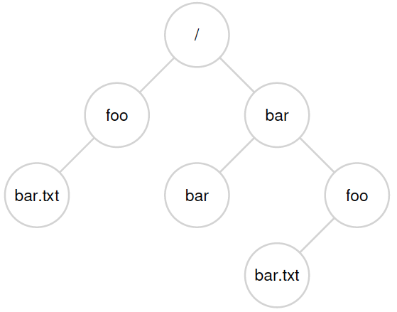
Directory
A directory, like a file, also has a low-level name,
i.e., an inode number
But its contents are quite specific:
Contains a list of (user-readable name, low-level name) pairs.
e.g.: an entry (“foo”, “10”)
Each entry in a directory refers to either files or other directories, enabling directory hierarchy.

Slide 7
Path
Separator: /
Absolute path: /foo/bar.txt
Relative path: foo/bar.txt

Slide 8
Outline
Abstraction: file
Abstraction: directory
Abstraction: file descriptors

Slide 9
File descriptor
It is a small integer representing a kernel-managed object that a process may read from or write to.
A process may obtain a file descriptor by opening a file, directory, or device, or by creating a pipe, or by duplicating an existing descriptor.
Its interface abstracts away the differences between files, pipes, and devices, making them all look like streams of bytes.

Slide 10
File descriptors in xv6
The xv6 kernel uses the file descriptor as an index into a per-process table
so that every process has a private space of file descriptors starting at zero.
By convention, a process has the following three file descriptors:
reads from standard input (file descriptor 0);
writes to standard output (file descriptor 1);
writes error messages to standard error (file descriptor 2).

Slide 11
Examples: essence of “cat”
char buf[512];
int n;
for(;;){
n = read(0, buf, sizeof buf);
if(n == 0)
break;
if(n < 0){
fprintf(2, "read error\n");
exit();
}
if(write(1, buf, n) != n){
fprintf(2, "write error\n");
exit();
}
}

Slide 12
Outline
Abstraction: file
Abstraction: directory
Abstraction: file descriptors
Basic APIs

Slide 13
Opening a file
int fd = open("foo", O_CREAT | O_WRONLY | O_TRUNC);
Returns a file descriptor (private integer).
File descriptor
Once a file is opened, you use the file descriptor to read or write the file, assuming you have permission to do so.
In this way, a file descriptor is a capability, i.e., an opaque handle that gives you the power to perform certain operations.
Another way to think of a file descriptor is as a pointer to an object of type file.

Slide 14
Creating a file
int fd = creat("foo");
open() can also create a file.
You can think of creat() as open() with the following flags: O CREAT | O WRONLY | O TRUNC.
Because open() can create a file, the usage of creat() has somewhat fallen out of favor.

Slide 15
Reading a file
ssize_t read(int fd, void *buf, size_t count);
It attempts to read up to count bytes from file descriptor fd into the buffer starting at buf.
On success, the number of bytes read is returned (zero indicates end of file), and the file position is advanced by this number.

Slide 16
Writing a file
ssize_t write(int fd, const void *buf, size_t count);
It writes up to count bytes from the buffer pointed buf to the file referred to by the file descriptor fd.
On success, the number of bytes written is returned (zero indicates nothing was written).
On error, -1 is returned.

Slide 17
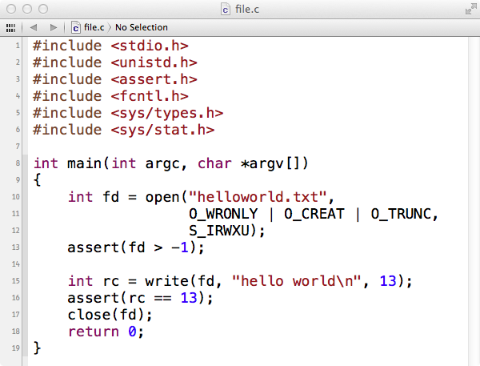
Example: file.c

Slide 18
Another example: copy
#include <sys/types.h>
#include <fcntl.h>
#include <stdlib.h>
#include <unistd.h>
#define BUF_SIZE 4096
#define OUTPUT_MODE 0700
int main(int argc, char *argv[])
{
int in_fd, out_fd, rd_count, wt_count;
char buffer[BUF_SIZE];
if(argc != 3) exit(1);
in_fd = open(argv[1], O_RDONLY);
if(in_fd < 0) exit(2);
out_fd = creat(argv[2], OUTPUT_MODE);
if (out_fd < 0) exit(3);
…
…
/* Copy loop */
while(1) {
rd_count = read(in_fd, buffer, BUF_SIZE);
if(rd_count <= 0) break;
wt_count = write(out_fd, buffer, rd_count);
if (wt_count <= 0) exit(4);
}
/* Close the files */
close(in_fd);
close(out_fd);
if (rd_count == 0)
exit(0);
else
exit(5);
}

Slide 19
Reading and writing, but not sequentially
off_t lseek(int fildes, off_t offset, int whence);
The first argument is a file descriptor.
The second argument is the offset, which positions the file offset to a particular location within the file.
The third argument, called whence for historical reasons, determines exactly how the seek is performed.

Slide 20
Writing Immediately with fsync(int fd)
With write(), the file system might buffer writes for some time.
With fsync(fd), the file system force all dirty (i.e., not yet written) data of the fd file to disk, and it returns once all of these writes are complete.
int fd = open("foo", O_CREAT|O_WRONLY|O_TRUNC, S_IRUSR|S_IWUSR);
int rc = write(fd, buffer, size);
rc = fsync(fd);

Slide 21
Renaming files
Change the name or move a file to a different directory with the same or different name.
Keep the same inode number.

Slide 22
Getting info about files
Metadata about files
struct stat {
dev_t st_dev; // ID of device containing file
ino_t st_ino; // inode number
mode_t st_mode; // protection
nlink_t st_nlink; // number of hard links
uid_t st_uid; // user ID of owner
gid_t st_gid; // group ID of owner
dev_t st_rdev; // device ID (if special file)
off_t st_size; // total size, in bytes
blksize_t st_blksize; // blocksize for filesystem I/O
blkcnt_t st_blocks; // number of blocks allocated
time_t st_atime; // time of last access
time_t st_mtime; // time of last modification
time_t st_ctime; // time of last status change
};

Slide 23
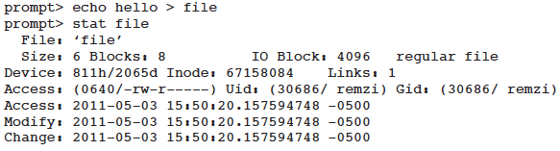
Getting info about files (cont’d)
https://www.tutorialspoint.com/unix_terminal_online.php

Slide 24

Removing files
Tool to trace system call
Linux: strace
Mac OS X: dtruss
unlink() just takes the name of the file to be removed, and returns zero upon success.
But this leads us to a great puzzle:
Why is this system call named “unlink”? Why not just “remove” or “delete”.
To understand the answer to this puzzle, we must first understand more than just files, but also directories.

Slide 25
Metadata about directories
struct dirent {
char d_name[256]; //filename
ino_t d_ino; //inode number
off_t d_off; //offset to the next dirent
unsigned short d_reclen; //length of this record
unsigned char d_type; //type of file
};

Slide 26

Making directories
When such a directory is created, it is considered “empty”, although it does have a bare minimum of contents.
Specifically, an empty directory has two entries:
one entry that refers to itself, “.”
one entry that refers to its parent, “..”

Slide 27
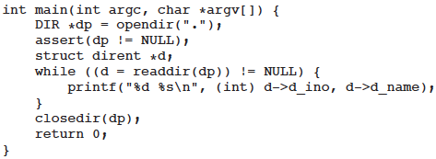
Reading directories
“ls” uses three calls, opendir(), readdir(), and closedir(), to get the job done.

Slide 28
Deleting directories
rmdir()
Unlike file deletion, however, removing directories is more dangerous, as you could potentially delete a large amount of data with a single command.
Thus, rmdir() has the requirement that the directory be empty (i.e., only has “.” and “..” entries) before it is deleted.
If you try to delete a non-empty directory, the call to rmdir() simply will fail.

Slide 29
Removing files (cont’d)
We study link() first.
Link() takes two arguments, an old pathname and a new one;
When you “link” a new file name to an old one, you essentially create another way to refer to the same file.
The command-line program ln is used to do this.

Slide 30
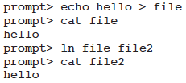


Hard links

Slide 31
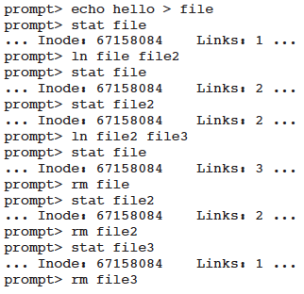
Unlink()
The reference count (or link count)
allows the file system to track how many different file names have been linked to this particular inode.
When unlink() is called, it
removes the “link” between the human-readable name to the given inode number;
decrements the reference count;
only when the reference count reaches zero does the file system also free the inode and related data blocks, and thus truly “delete” the file.
reference count

Slide 32



Symbolic(soft) links
A symbolic link is actually a file itself, of a different type.
It holds the pathname of the linked-to file as the data of the link file. It takes 4 bytes.

Slide 33

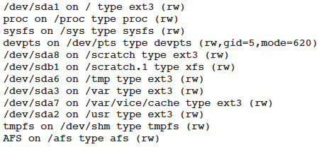
Making and mounting a file system
prompt> mount

